Slide 1


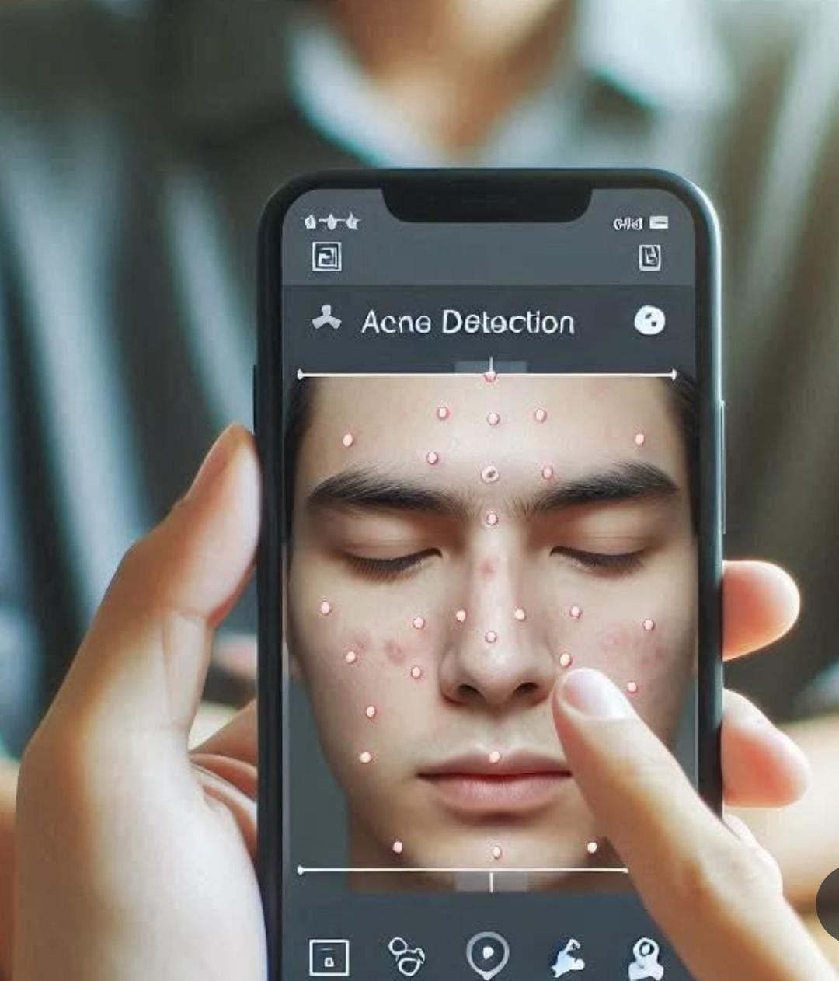
BIRLA INSTITUTE OF TECHNOLOGY, MESRA, OFF CAMPUS JAIPUR
SPOT FLAW
AI-Driven Visual Classification for Enhanced Skin Health Monitoring
Your personal AI dermatologist — accurate, instant, and always available

Slide 2






Problem Statement
Spotflaw delivers dermatology-level diagnosis in seconds — no appointments, no guessing
Widespread Issue
Acne affects over 200 million Indians, particularly teenagers and young adults aged 18-25
Lifestyle Factors
Modern lifestyle elements, such as increased stress, high- glycemic diets and environmental pollution
Health Impact
Acne can lead to scarring, infections, and significant mental health challenges.
Self-Diagnosis Risk
Limited Access
Around 87% of individuals resort to self-diagnosis and over-the- counter treatments.
With only 6,600 dermatologists serving 1.4 billion people, access to professional skin care is severely limited.

Slide 3
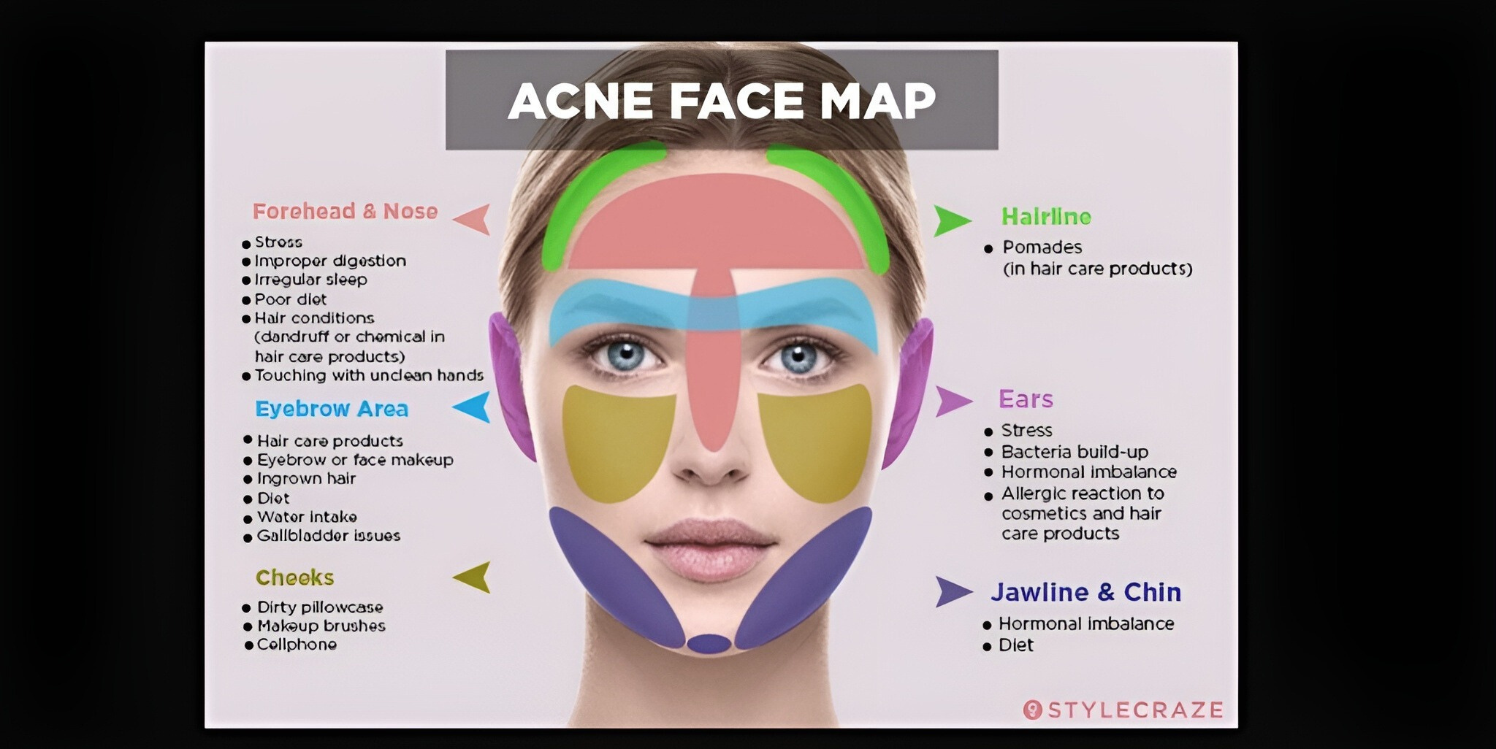

Slide 4





Solution And Working
Spotflaw uniquely combines AI and medical insight to not only detect acne, but reveal the root cause — instantlyxt
User-Friendly Platform
Face Image Scan
Image Analysis
Image Classification
User uploads a clear facial image for analysis.
Advanced AI scans the image to detect acne patterns.
ML model (CNN) categorizes acne types and identifies possible causes.
A website offering possible cause and skincare recommendations.

Slide 5

DATA PREPARATION & MODEL ARCHITECTURE
Data Preparation
Model Architecture
Dataset Composition: 2,346 images Annotation Classes: Class 0 - Acne: Bumpy, white/brown cysts, NOT RED Class 1 - Pimple: Bumpy, red/white cysts, MUST BE RED Class 2 - Spots: Flat, small, dark brown spots
Model Selection: Computer Vision, Convolutional Neural Network (CNN) Layers Overview: Conv2D: Feature extraction MaxPooling2D: Down-sampling Flatten: Converts 2D matrix to a vector Dense: Fully connected layers for classification Dropout: Prevents overfitting

Slide 6
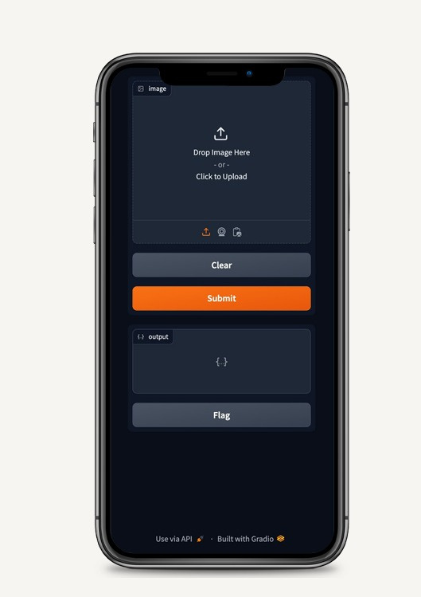
USER INTERFACE PREVIEW
1.Click on the link
2.Upload an image of yourself in a well lit environment. Avoid wearing bindi or any piercing.
3.The image will be detected by the model and you'll get the necessary information about it.

Slide 7
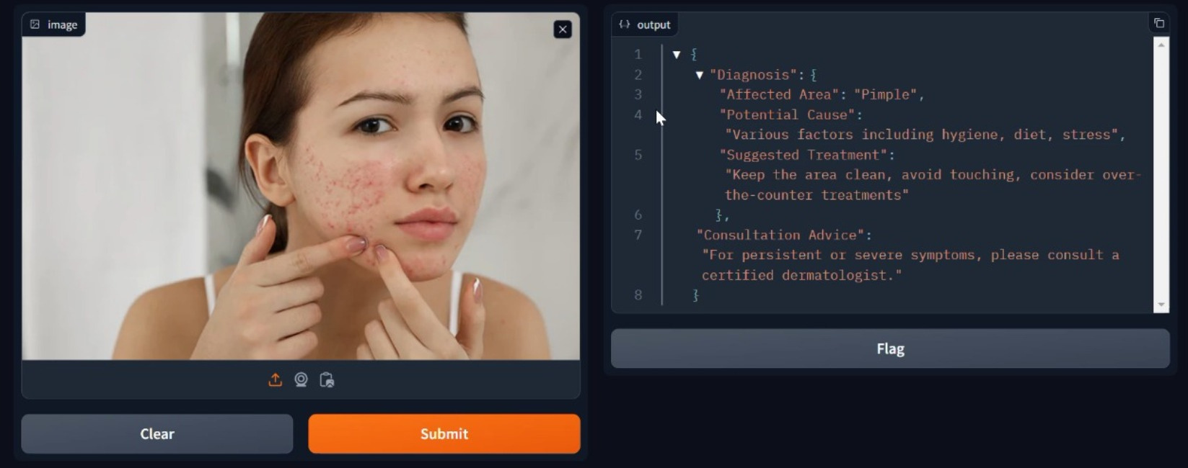

Slide 8
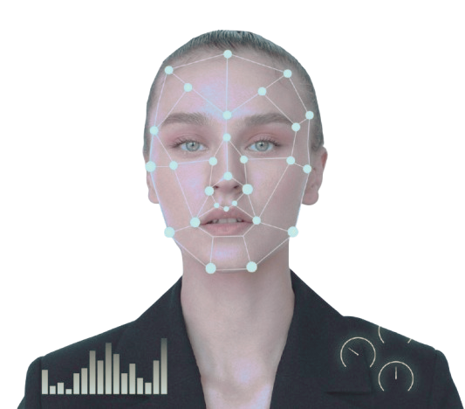




ROLE OF AI/ML
Computer Vision + Convulational Neural Network (CNNs)
Facia image is uploaded or captured.
1
Feature Extraction : Automatically learns important features (edges, textures, colors).
Spatial Hierarchy: Captures relationships between pixels in an image.
Efficiency: Reduces manual feature
engineering, improving
performance.
Real-World Use Cases: Medical
imaging, facial recognition,
autonomous vehicles.
2
3
4

Slide 9
FUTURE SCOPE
1
FACIAL PRECISION
4
EXPERT CONNECT
We'll train our AI model with diverse, high-quality facial images to boost accuracy.
Help users locate dermatologists by location, providing contact details and addresses.
3
PERSONALIZED CHATBOX
Provide product recommendations based on detected skin conditions.
2
SKINCARE CHATBOX
5
FUNDUS IMAGING
A chatbot that answers common skincare queries based on AI analysis.
Advanced imaging and AI tools enhance fundus analysis for early detection of diabetic eye diseases

Slide 10
TEAM- SPOT FLAW
VEDANSHI GOYAL
NAVYA KHANDELWAL
ANJALI BANWANI
MRIDUL KRISHNA SHARMA
FACULTY COORDINATOR : MR. VISHWAMBHAR PATHAK

